Slide 1
HOSPITAL READMISSION ANALYSIS
Insights from Diabetes 130-Hospitals Dataset (UCI)
By Santosh Kr. Majhi
22 JULY 2025

Slide 2
OBJECTIVE
Goal: Identify patterns andpredictors of hospital readmission
Key Focus Areas:
Impact of age & gender
Length of stay & medication
Readmission within 30 days

Slide 3
DATASET OVERVIEW
Source: UCI ML Repository
Records: 100,000 hospital visits
Time period: 1999–2008
Key variables:
age, gender, time_in_hospital
num_medications, readmitted
A1Cresult, diabetesMed

Slide 4
DATA CLEANING
Dropped: weight, payer_code, encounter_id
Replaced '?’: NaN → handled missing values
Encoded target variable: readmitted
Converted age brackets into ordered groups

Slide 5
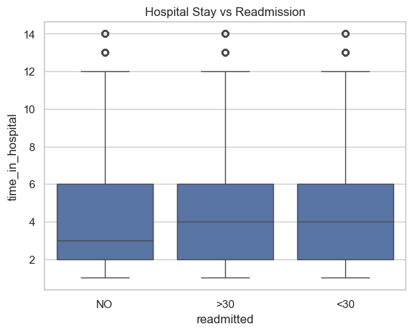
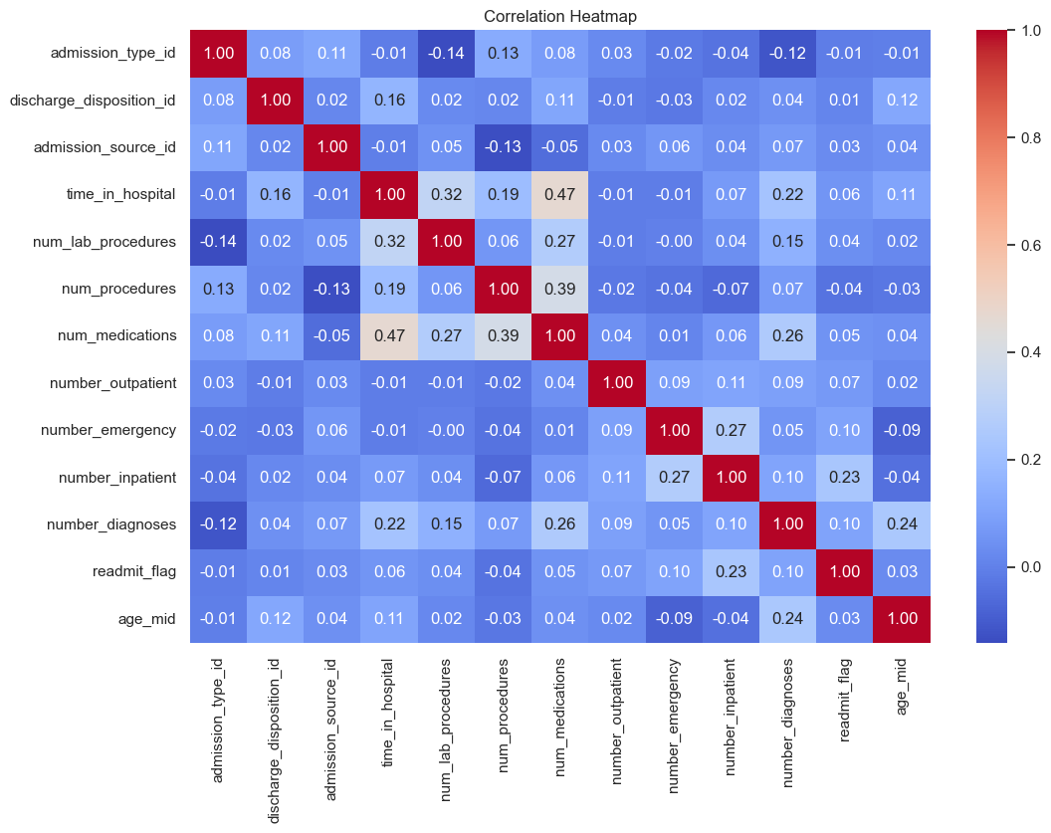
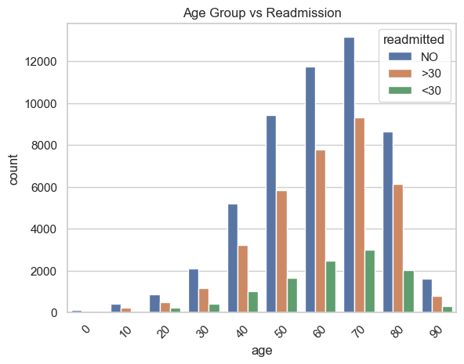
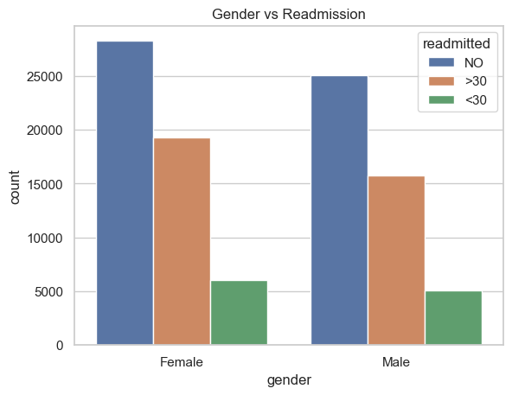
EXPLORATORY DATA ANALYSIS
Age vs Readmission: Higher readmissions in 70–80 group
Gender Trends: Slightly more female readmissions
Time in Hospital: Longer stays → more readmissions
Medications: >10 → increased readmission risk

Slide 6
CORRELATION & HEATMAP
Heatmap of numeric features
Observations:
- num_medications & time_in_hospital: weakly correlated
- No strong collinearity but useful trends for EDA

Slide 7
KEY INSIGHTS & TAKEAWAYS
Seniors (70+) more likely to be readmitted
High medication count & insulin use → risk factors
Gender/diabetesMed show subtle trends
Recommendation:
Focus on preventive care for high-risk age-medication profiles

Slide 8
THANK YOU

